Slide 1
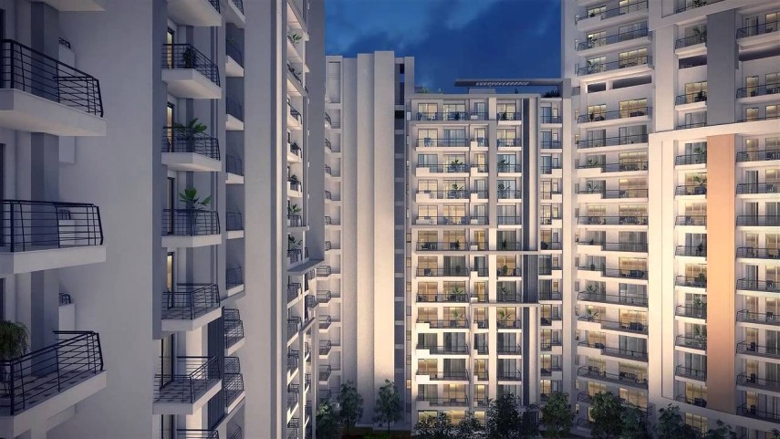
CARE 4 U
A HSS Management System
Presented by “Team Diplomats”

Slide 2
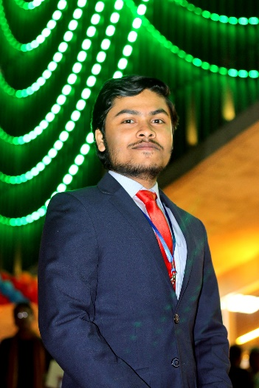
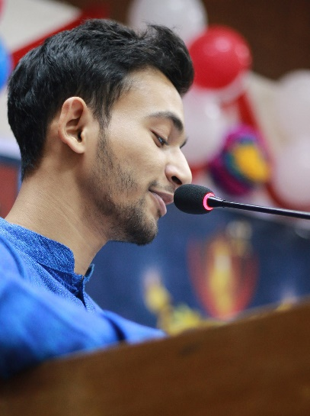


v
OUR
TEAM
Tanvir Ahmed Rahat
CSE06307397
Nur Mohammed Rana
Abdullah Basar Maruf
CSE06307478
CSE06307404
Team Diplomats
Khadija Akhter Rono
CSe06307480

Slide 3

Easy to Access
Vast Opportunities
Provide Quality Service
OUR
AGENDA
Solving Real Life Problem
Sufficient Resource for Collecting Data

Slide 4
INTRODUCTION
What is HSS
Types of HSS
Provide Service for this
Project
Taking care by Management Committee which is a group of people who are elected by the society residents to handle all the apartment society operations.
Ownership housing society
Joint ownership
Other co-operative housing society.
In order to deliver the highest standard of a service and provide excellence.

Slide 5
Features
24/7 Customer Service
01
Web Based UI
02
Secured Registration Process
03

Slide 6
Features
Elite Membership facilities
04
Customer Feedback Review
05
One call away service
06

Slide 7
Feasibilities for this project
Technical
Feasibilities
Economical
Operational

Slide 8
Technical Feasibilities
Hardware
Laptop & PC
Internet Connection
Software
Open Source Software
OS as Windows
Technology
Up to date
User friendly

Slide 9
Economical Feasibilities
Availability of software and hardware
Cost efficient
Low Budget
Data Collection & information gathering cost
Technical cost
Other cost

Slide 10
Operational feasibility
User level
Amateur
User Interface
User-friendly, efficient & simple
Troubleshooting
Proper actions to identify errors
Maintenance
Optimized short run

Slide 11
Project Scheduling
Analysis
Planning
Construction
Deployment

Slide 12
Analysis
Activity | Description | Precedence | Time (in week)
01 | Project Study & Goal Setup | none | 01
02 | Meeting with Clients | 01 | 01

Slide 13
Planning
Activity | Description | Precedence | Time (in week)
03 | Collecting requirements | 01 | 01
04 | Detailed requirements | 02 | 1
05 | Proposition of requirements | 02 | 1

Slide 14
Construction
Activity | Description | Precedence | Time (in week)
06 | Database Development | 05 | 03
07 | UI Design | 05 | 02
08 | Coding | 07 | 03

Slide 15
Deployment
Activity | Description | Precedence | Time (in week)
09 | Software Testing | 08 | 02
10 | Feedback & Launching | 09 | 01

Slide 16
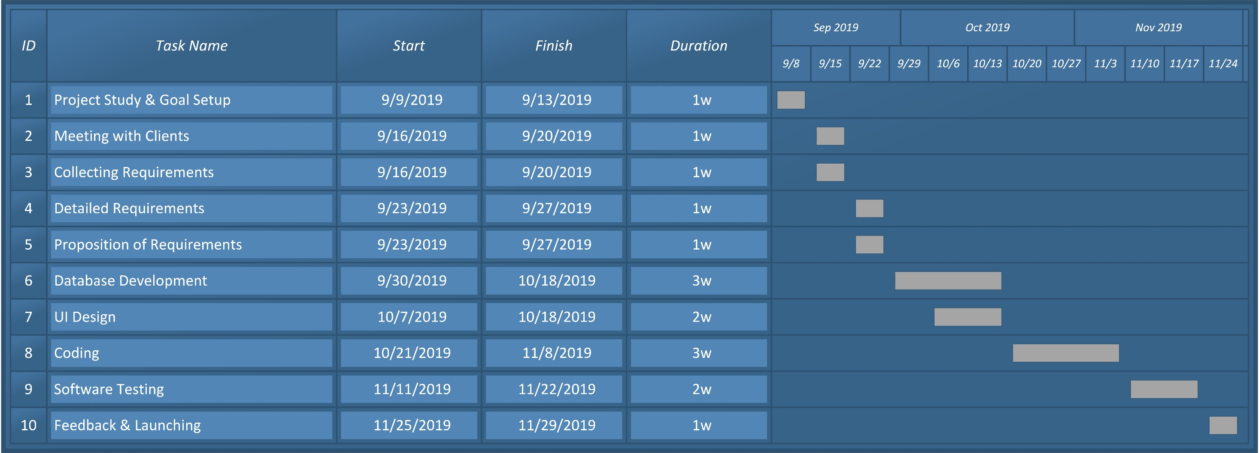
Gantt Chart

Slide 17
Risk Analysis
Backup for database
Secured Database & Registration form with secured process
Timing Commitment
Hardware backup

Slide 18

Team Diplomats
v
THANK YOU
CONTACT US
abdullahmaruf86@gmail.com

